Slide 1
Petar Mazev
Modern Macedonian art

Slide 2
Petar Mazev
Petar Mazev was born in Kavadarci, on 10th February, 1927, and he passed away on 13th March, 1993.
Mazev is a Macedonian painter and he is one of the most important painters of contemporary Macedonian art.

Slide 3
Life of Mazev
He graduated from the Academy of Art in Belgrade, 1953.
He was a member of the artistic group called “Mugri”.
He was a professor at the Faculty of Architecture in Skopje.
Petar Mazev is one of the main initiators for the establishing of the Faculty of Art in Skopje.

Slide 4
Creativity of Petar Mazev
Macedonia is a substrate of strong emotional experience for Petar Mazev. In his art system, the plastic tradition of the nation invades in a figurative sense. Mazev was more excited by the unusual harsh, dramatic contrast of the country’s geographical structure, the spirit of the past and the patina that is pressed into its substance, the old buildings and objects.
He was so close to the feeling of the effects of the material which are characteristic for some works by Anthony Tapie and Alberto Burri. However, the abstract naturalism of Mazev contains strive to refrain from instinctive expressionism, harmonization of the material in strict systems within the frames of almost monochromatic images.

Slide 5
Creativity of Petar Mazev
At the beginning, Mazev drew his first drawings with charcoal from burnt wood which is why he got his nickname “Khukho”. He passed through several stages of development during his successful artistic career: the expressionist realism, surrealism, informel and eventually to return to the figure.
He is famous for and recognized as one of the most skilful colorists in the contemporary Macedonian painting.

Slide 6
Creativity of Petar Mazev
The last stage of Mazev’s creativity came out of the already associative matter of his works and it moved to the unusual plastic agglomerations.
He received the October prize for painting in 1960, the November award of the city of Skopje in 1977, etc.
He had solo exhibitions in Skopje and took part in many group exhibitions in the country and abroad: Burma, China, India, France, Chile, Milan, and Belgrade.
His most important works are: “Monastery Landscape”, “Ripe Grain”, the mural in Zelezarnica in Skopje, the mosaic in Stopanska Bank and the State hospital in Skopje, and the mosaic on the monument to the Ilinden Uprising in Krushevo.

Slide 7
Works by Petar Mazev

Slide 8
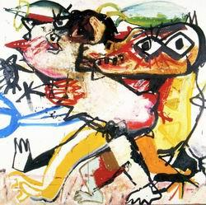

Slide 9
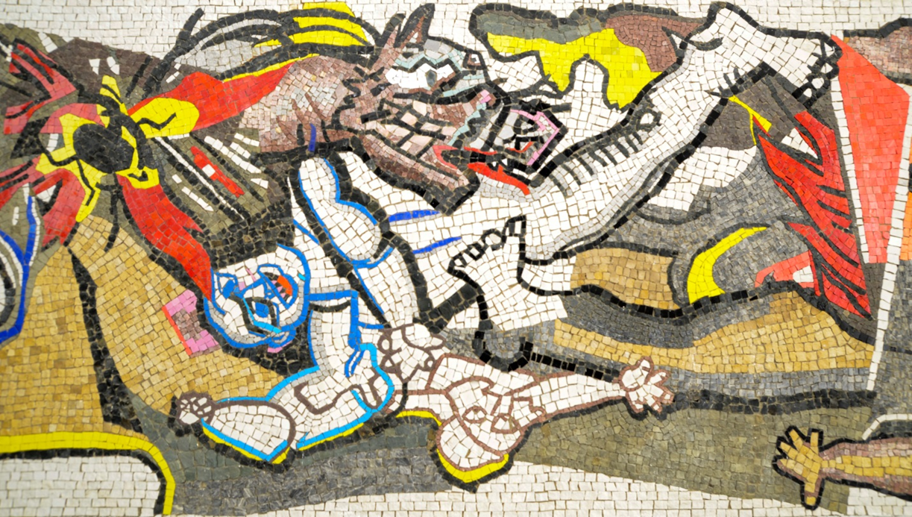

Slide 10
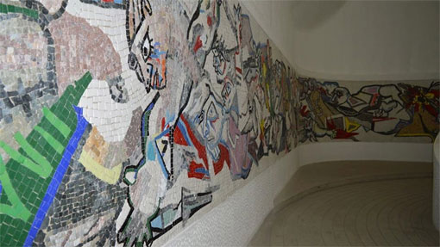

Slide 11
